Slide 1

Low Voltage System
Vasilis Amoiridis
Sokratis Koseoglou

Slide 2


Low Voltage System
Presentation Chronicle
Part Two
Part Four
Internal Resistance PCB
Part Three
Part Five

Slide 3

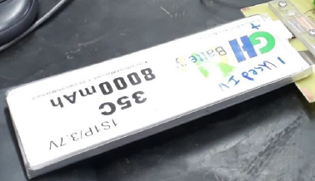
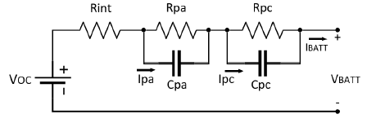
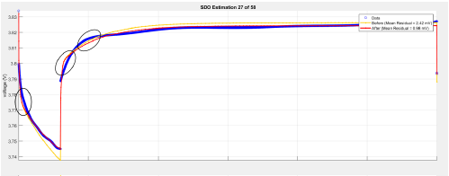

Low Voltage System
Internal Resistance PCB
Rint

Slide 4
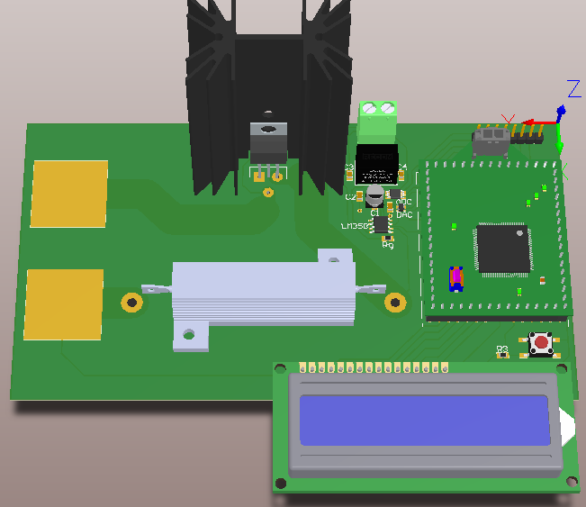
Low Voltage System
Internal Resistance PCB
Altium Design…
ADC
DAC
MCU
LCD

Slide 5
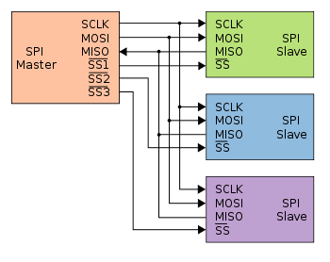
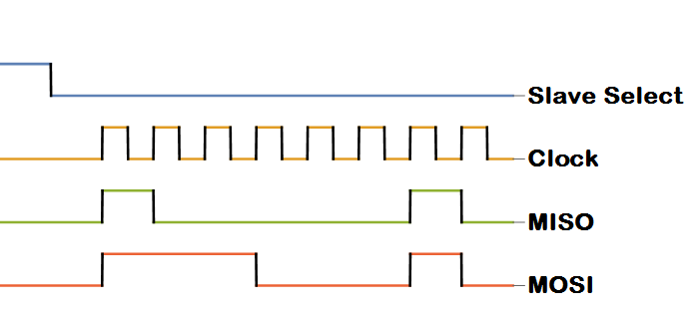
Low Voltage System
Internal Resistance PCB
SPI (Serial Peripheral Interface)
Multi-Slave Protocol
How it works…

Slide 6
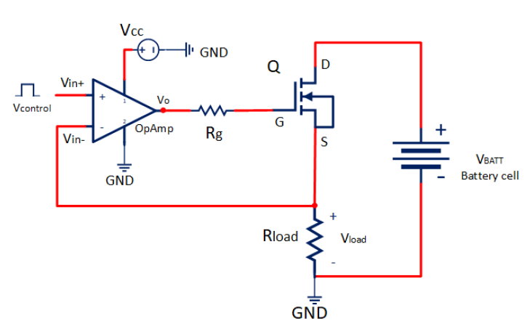
Low Voltage System
Software Design…
Internal Resistance PCB
Read Button
If Pressed
DAC output
Read V_load
If (V_Control == V_load)
Read V_batt
Rint = |Vbatt – Voc| / Id
LCD Print

Slide 7


UESTIONS

Slide 8


